Slide 1


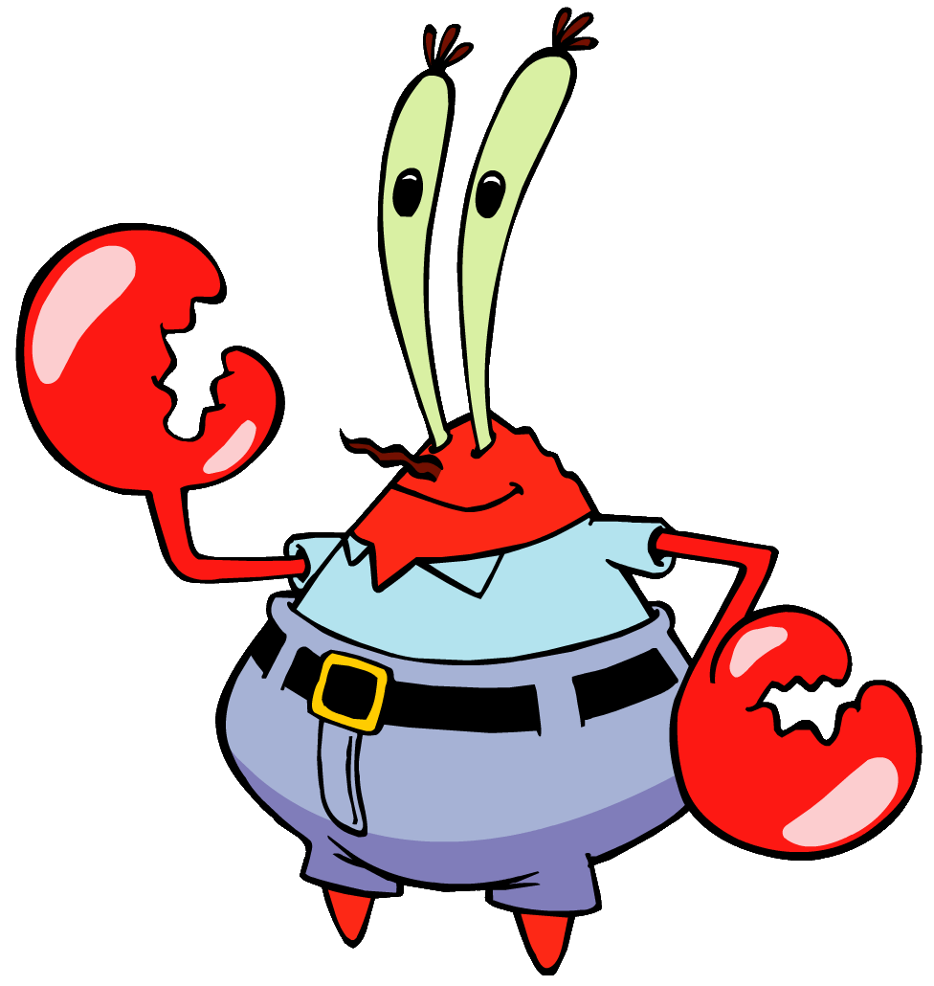
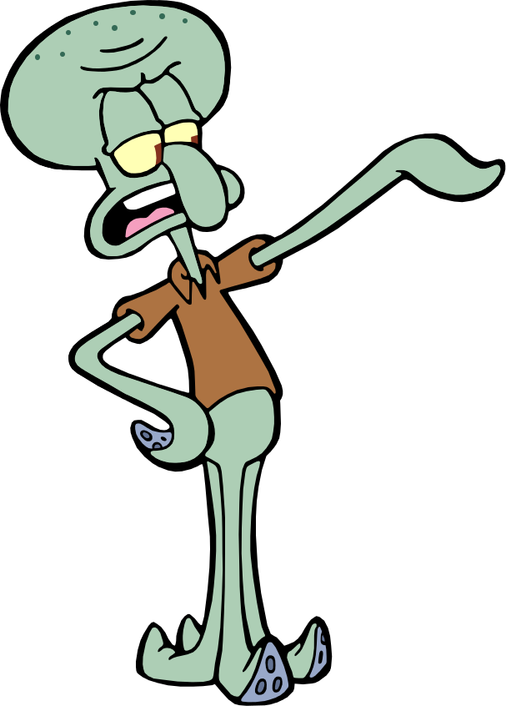

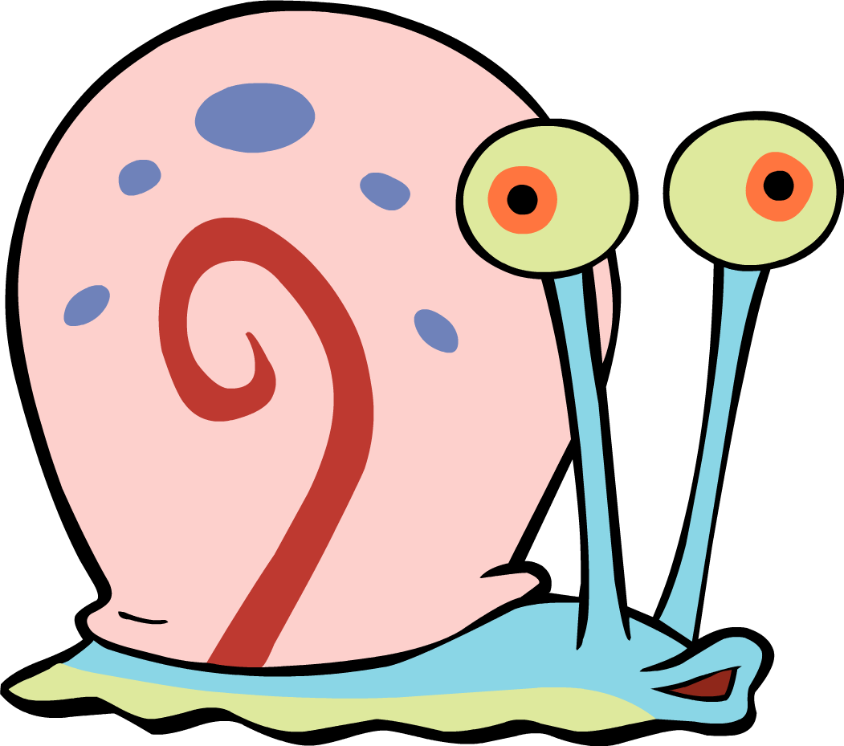

Patrick Wu Shawn Tan George Millo Ashly Lau Joel Ngana Paulina Kulyte
Group 19 - Patrick & The Crew

Slide 2
Outline
The problem
DEMO
The tech
Next steps
Notes:
Centralised platform for users to access personalized content and services
Resources for 1-to-1 counselling are limited
Website has many resources, but is difficult to navigate

Slide 3
1st Problem – User Experience
Notes:
Centralised platform for users to access personalized content and services
Resources for 1-to-1 counselling are limited
Website has many resources, but is difficult to navigate

Slide 4
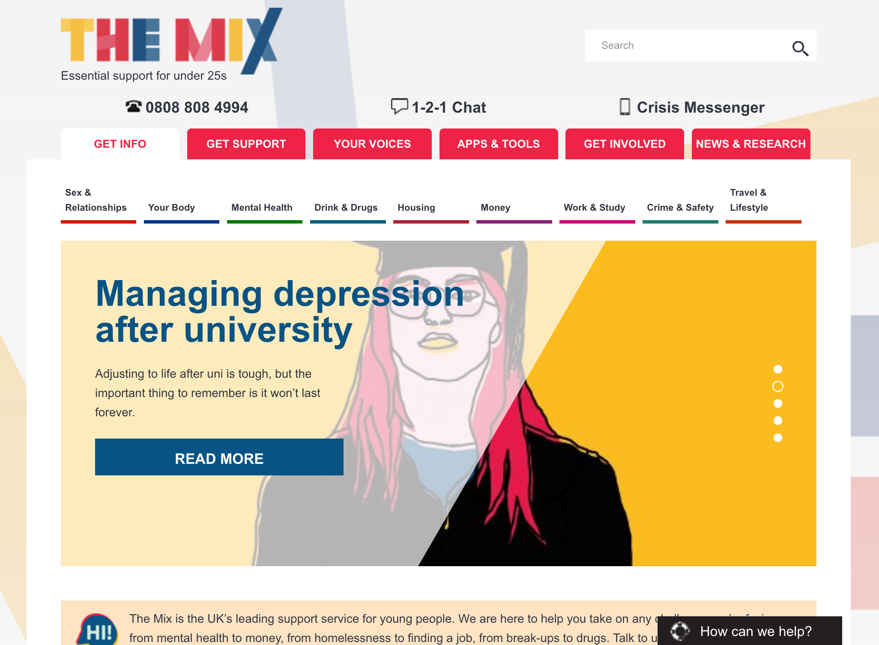
The Problem
Notes:
Centralised platform for users to access personalized content and services
Resources for 1-to-1 counselling are limited
Website has many resources, but is difficult to navigate

Slide 5
2nd Problem - Personalization
Notes:
Centralised platform for users to access personalized content and services
Resources for 1-to-1 counselling are limited
Website has many resources, but is difficult to navigate

Slide 6
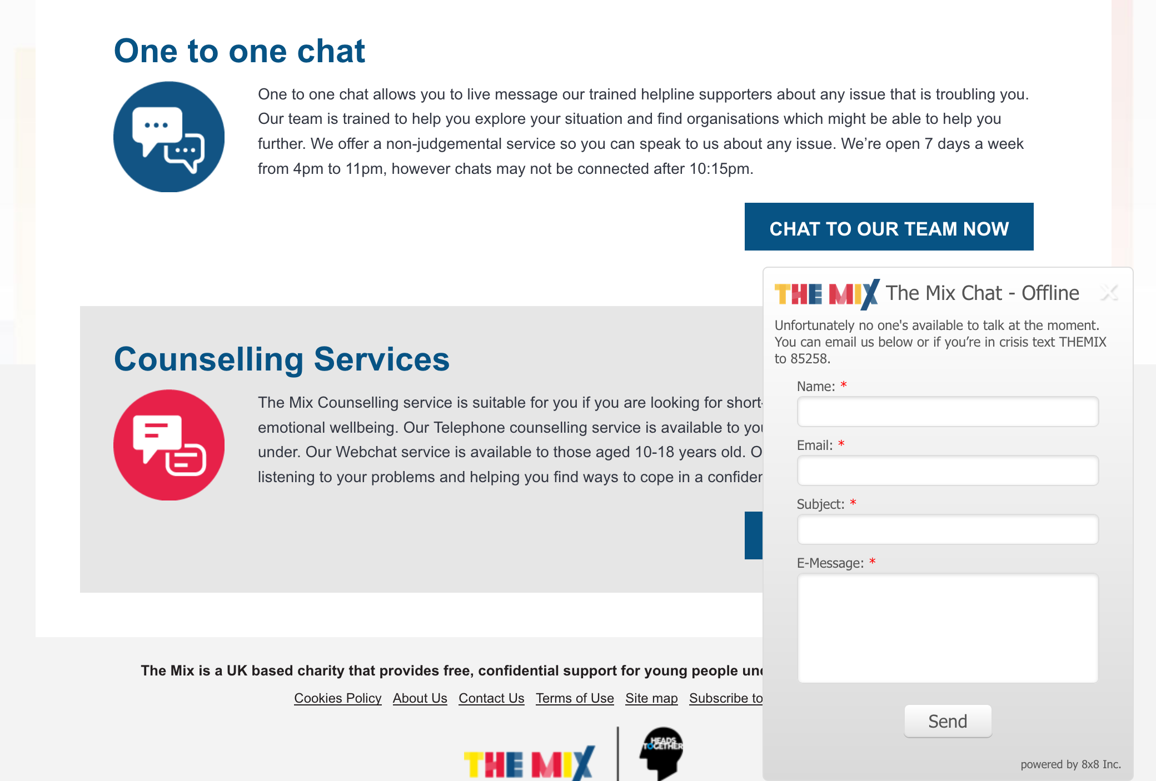
Notes:
Centralised platform for users to access personalized content and services
Resources for 1-to-1 counselling are limited
Website has many resources, but is difficult to navigate

Slide 7
The Solution
ChatBot
Notes:
Centralised platform for users to access personalized content and services
Resources for 1-to-1 counselling are limited
Website has many resources, but is difficult to navigate

Slide 8
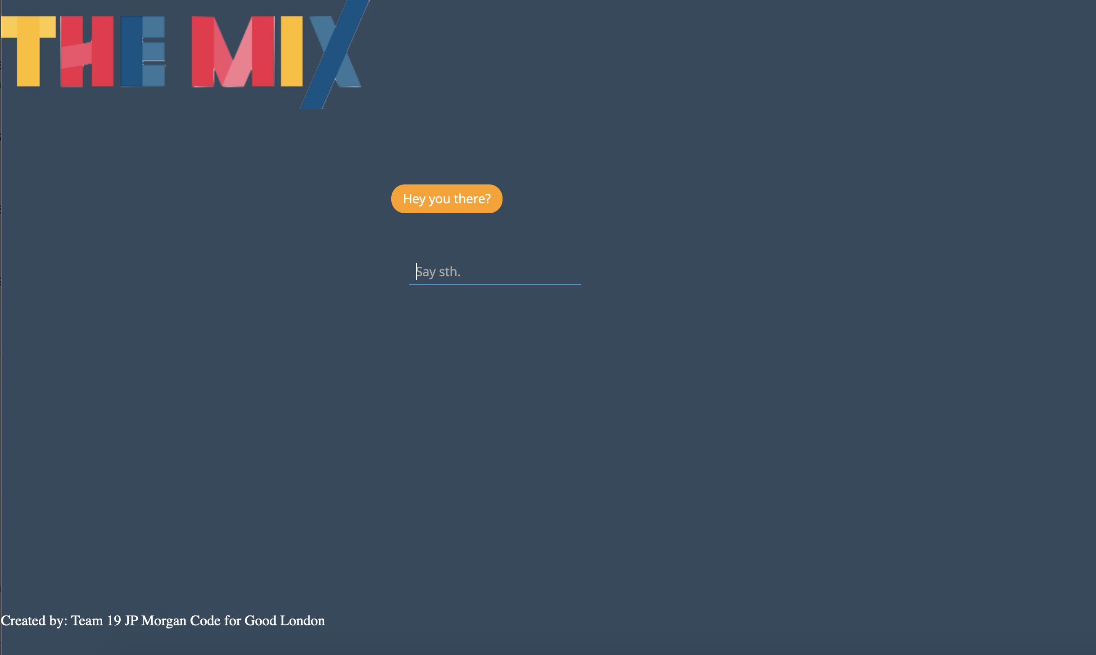

Slide 9
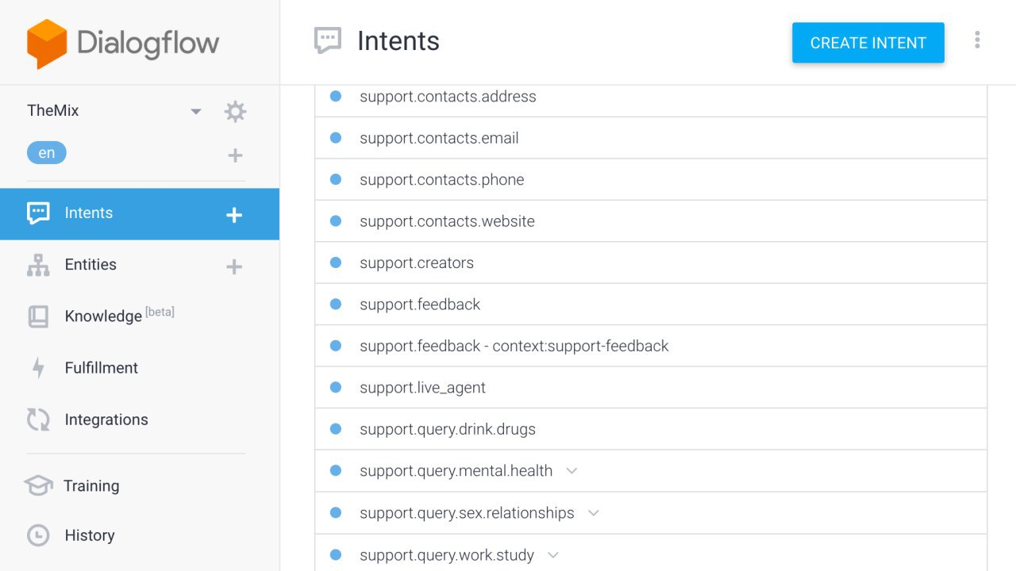
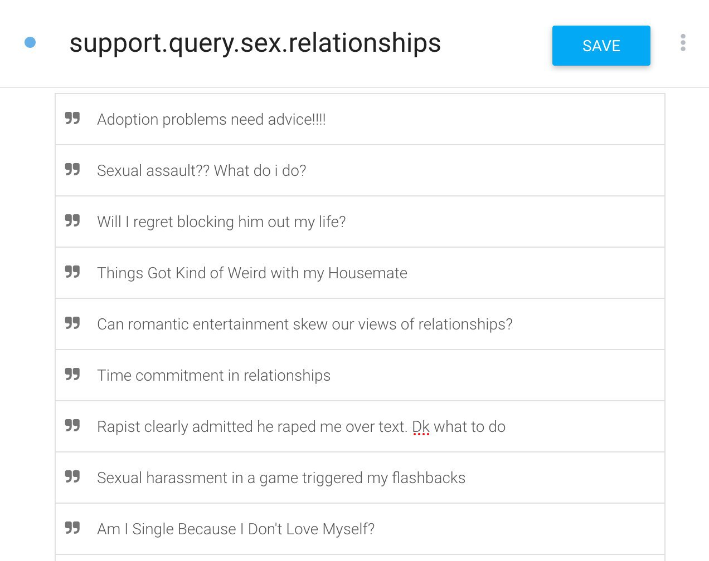

Notes:
Centralised platform for users to access personalized content and services
Resources for 1-to-1 counselling are limited
Website has many resources, but is difficult to navigate

Slide 10



The Other Techs
Front
Back
Notes:
Centralised platform for users to access personalized content and services
Resources for 1-to-1 counselling are limited
Website has many resources, but is difficult to navigate

Slide 11
The Solution
Centralized Platform
Personalized User Experience
Notes:
Centralised platform for users to access personalized content and services
Resources for 1-to-1 counselling are limited
Website has many resources, but is difficult to navigate

Slide 12
Imitates human interaction
Returns content based on the users issue
Personalized User Experience
Notes:
Centralised platform for users to access personalized content and services
Resources for 1-to-1 counselling are limited
Website has many resources, but is difficult to navigate

Slide 13
All resources are in one place
Easy to navigate
Centralized Platform
Notes:
Centralised platform for users to access personalized content and services
Resources for 1-to-1 counselling are limited
Website has many resources, but is difficult to navigate

Slide 14
Next step – Make use of the data collected
Monitoring
Data Analysis
Advanced modelling
Notes:
Centralised platform for users to access personalized content and services
Resources for 1-to-1 counselling are limited
Website has many resources, but is difficult to navigate

Slide 15
Next step – Scalability
Front-End
Back-End
Notes:
Front end – Just UI with API scalability to any other Back end you prefer
Back end – If more data could have avoid Hybrid Algorithm -> Straight up ML with large datasets yield better results.

Slide 16
Thank you!

